Slide 1
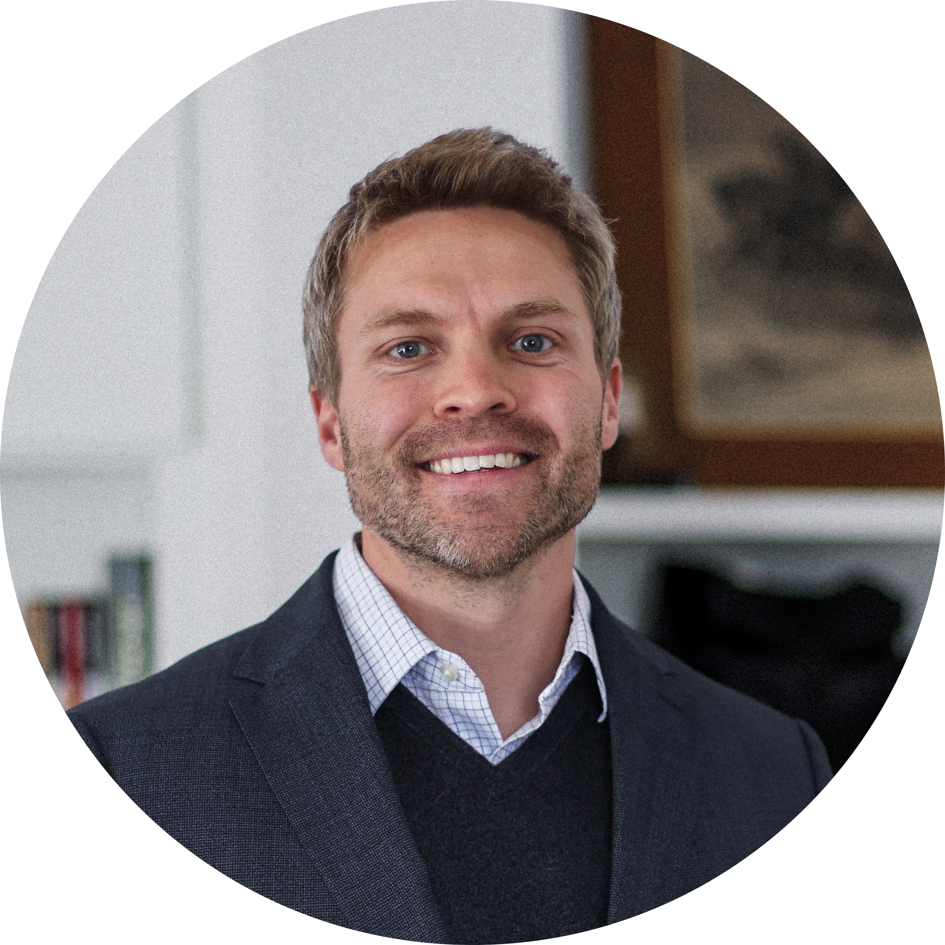
Matt Tokoly Sr. Manager
Cloud & Product
Email
matt.tokoly@thebridge.com
Location
Fort Worth, Texas
Phone
(512) 578-9381
EXPERIENCE
Matt joined The Bridge in February 2024. He is a passionate and committed engineer with over 15 years of experience in leading, architecting, and implementing complex applications. He has an advanced knowledge of developer applications, tools, methodologies and best practices.
Industry Experience
Logistics & Transportation | State Government | Engineering & Construction | E-Commerce | Real Estate
Freight Logistics Strategy | Logistics and Transportation
Architected and engineered the new freight dispatch and route planning application. Tonnage (Left-to-Load) served as the cornerstone application empowering Yellow Dispatch Officers in orchestrating the seamless dispatch and movement of freight across an extensive network of over a thousand facilities nationwide.
Addressing the intricacies of Automated Meet-and-Turns, a critical operational facet within the trucking domain, I spearheaded initiatives aimed at streamlining dispatch processes. This involved automating the allocation and synchronization of trucks, drivers, trailers, and shipments. Automating the process saved hundreds of personnel hours for Yellow Dispatch Officers.
Technology and Infrastructure | State Government and Higher Education
Managed and nurtured a team of software engineers, spearheaded the University's CI/CD implementation, created middleware tools that were used by dozens of engineering teams
Creator of UTX, an integrated set of tools addressing standardized templating/design, authentication, form management, and UT specific utilities, distributed as campus-wide middleware
Lead Architect and Engineer of the UT Space API, UT Location API, UT Tableau Authentication Middleware API, and Directory Information API
Lead Engineer and Architect for SafeRide, a mobile application that has increased safety and security by allowing students to request rides across campus
Lead Engineer for UT Line, an e-commerce application with an annual revenue of over $400k that allow faculty and staff to purchase customizable business cards and stationery
Technical Lead for IWMS – a project with a $5 million-dollar budget for selecting and integrating the latest Work Management System
BACKGROUND
Functional Skills
Engineering Management and Leadership, Software Architecture Design and Development
Qualifications
My technical expertise includes fluency in several programming/scripting languages (including Java, Python, Dart, Swift, PHP, Bash/Shell, JavaScript, and SQL); Docker/Jenkins, REST/SOAP API microservices, Linux system administration; and an advanced knowledge of developer applications, tools, methodologies, and best practices.

Slide 2

Email
matt.tokoly@thebridge.com
Location
Fort Worth, Texas
Phone
(512) 578-9381
Matt joined The Bridge in February 2024. He is a passionate and committed engineer with over 15 years of experience in leading, architecting, and implementing complex applications. He has an advanced knowledge of developer applications, tools, methodologies and best practices.
Matt Tokoly Senior Manager
Cloud and Product

Slide 3
Matt Tokoly Sr. Manager – Cloud & Product
Email
matt.tokoly@thebridge.com
Location
Fort Worth, Texas
Phone
(512) 578-9381
BACKGROUND
EXPERIENCE
Functional Skills
Engineering Management and Leadership, Software Architecture Design and Development
Qualifications
My technical expertise includes fluency in several programming/scripting languages (including Java, Python, Dart, Swift, PHP, Bash/Shell, JavaScript, and SQL); Docker/Jenkins, REST/SOAP API microservices, Linux system administration; and an advanced knowledge of developer applications, tools, methodologies, and best practices.
Industry Experience
Logistics & Transportation | State Government | Engineering & Construction | E-Commerce | Real Estate
Freight Logistics Strategy | Logistics and Transportation
Architected and engineered the new freight dispatch and route planning application. Tonnage (Left-to-Load) served as the cornerstone application empowering Yellow Dispatch Officers in orchestrating the seamless dispatch and movement of freight across an extensive network of over a thousand facilities nationwide.
Addressing the intricacies of Automated Meet-and-Turns, a critical operational facet within the trucking domain, I spearheaded initiatives aimed at streamlining dispatch processes. This involved automating the allocation and synchronization of trucks, drivers, trailers, and shipments. Automating the process saved hundreds of personnel hours for Yellow Dispatch Officers.
Technology and Infrastructure | State Government and Higher Education
Managed and nurtured a team of software engineers, spearheaded the University's CI/CD implementation, created middleware tools that were used by dozens of engineering teams
Creator of UTX, an integrated set of tools addressing standardized templating/design, authentication, form management, and UT specific utilities, distributed as campus-wide middleware
Lead Architect and Engineer of the UT Space API, UT Location API, UT Tableau Authentication Middleware API, and Directory Information API
Lead Engineer and Architect for SafeRide, a mobile application that has increased safety and security by allowing students to request rides across campus
Lead Engineer for UT Line, an e-commerce application with an annual revenue of over $400k that allow faculty and staff to purchase customizable business cards and stationery
Technical Lead for IWMS – a project with a $5 million-dollar budget for selecting and integrating the latest Work Management System

